Slide 1
Image Restoration
(Deblurring & Denoising)
CS 663: Introduction to Digital Image Processing
190100027: Ashutosh Sharma
180100060: Kritti Sharma
180260037: Shreyas Chandgothia

Slide 2
Work Distribution
Ashutosh
(190100027)
Deblurring using Reverse Mean Shift implementation
Reverse Mean Shift tests on non space-varying and space-varying Gaussian blurred images
Kritti
(180100060)
Reverse Heat Equation implementation
Reverse Heat Equation tests on non space-varying and space-varying Gaussian blurred images
Theory of Reverse Heat Equation and Reverse Mean Shift
Forward Mean Shift tests on Gaussian noisy images
Denoising and deblurring using combination of forward and reverse mean shift implementation
Shreyas
(180260037)

Slide 3
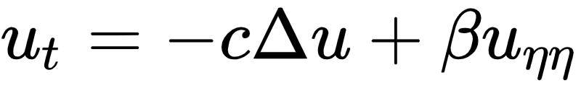
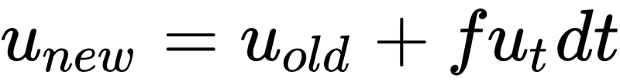
Reverse Heat Equation
c = diffusion coefficient dt = update time resolution
𝜷 = stability term coefficient f = boolean, whether to update pixel
Modifications & Implementation Details
Normal component derivative computation: Added one in the denominator to avoid it from shooting in constant intensity regions
Pixel selection for updates: Stop updating a pixel when curvature at that pixel does not change by more than a threshold change in curvature
Stopping criterion for iterations
Non space-varying Gaussian blur: Stop iterating when the change of curvature for 50% of the pixels in the image is more than a threshold curvature
Space-varying Gaussian blur: Stop iterating when the change of curvature for all of the pixels in the image is more than a threshold curvature
Update time resolution
Non space-varying Gaussian blur: Coarse time updates with 1 s resolution gave good results
Space-varying Gaussian blur: Fine time updates with 0.1 s resolution gave good results

Slide 4
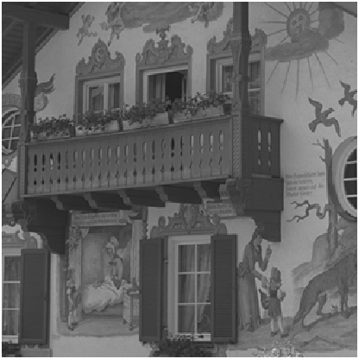
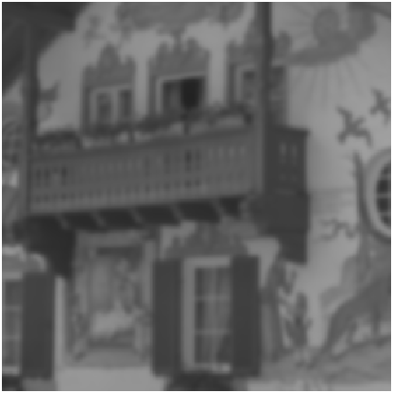

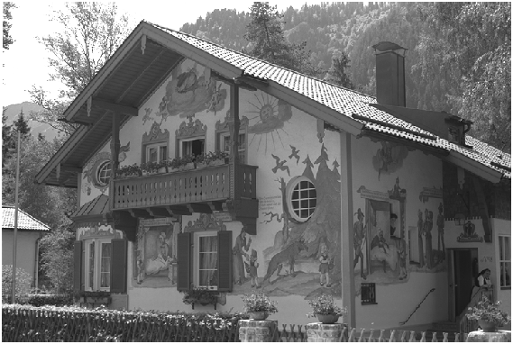
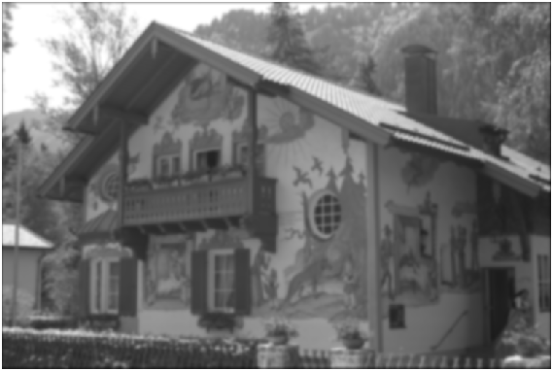

Reverse Heat Equation ~ Kodak ~ 𝝈 = 2 Gaussian Blur
Technique
Coarse grid search on parameters followed
by manual parameter fine tuning
Parameters
c = 0.8, 𝜷 = 0.08, dt = 1, n_iter = 10, 𝜽 = 0.1
Convergence at 3rd iteration
Original Kodak Image
Gaussian Blurred (𝝈 = 2): PSNR = 22.64dB
Deblurred Image: PSNR = 24.51dB

Slide 5



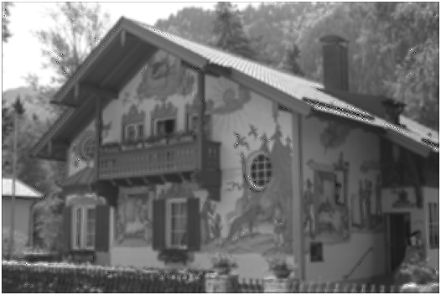
Reverse Heat Equation ~ Kodak ~ 𝝈 = 3 Gaussian Blur
Technique
Coarse grid search on parameters followed
by manual parameter fine tuning
Parameters
c = 0.76, 𝜷 = 0.08, dt = 1, n_iter = 10, 𝜽 = 0.1
Convergence at 5th iteration
Original Kodak Image
Gaussian Blurred (𝝈 = 3): PSNR = 21.58dB
Deblurred Image: PSNR = 22.50dB

Slide 6
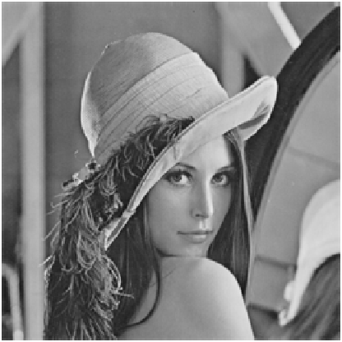

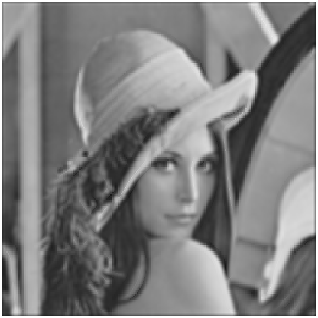


Reverse Heat Equation ~ Lena ~ 𝝈 = 2,3 Gaussian Blur
Technique
Coarse grid search on parameters followed
by manual parameter fine tuning
Observations
For high standard deviation gaussian blur,
we are not able to achieve visually good deblur
Parameters - 𝜎 = 2
c = 0.65, 𝜷 = 0.11, dt = 1, n_iter = 10, 𝜽 = 0.08
Convergence at 4th iteration
Parameters - 𝜎 = 3
c = 0.5, 𝜷 = 0.13, dt = 1, n_iter = 10, 𝜽 = 0.02
Convergence at 4th iteration
Original Lena
𝝈 = 2: PSNR = 23.54dB
𝝈 = 2: PSNR = 25.98dB
𝝈 = 3: PSNR = 21.88dB
𝝈 = 3: PSNR = 23.00dB

Slide 7
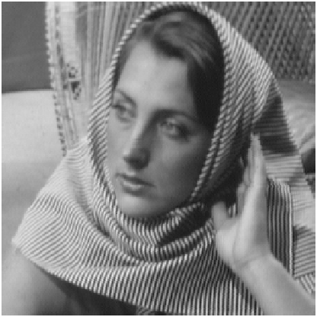
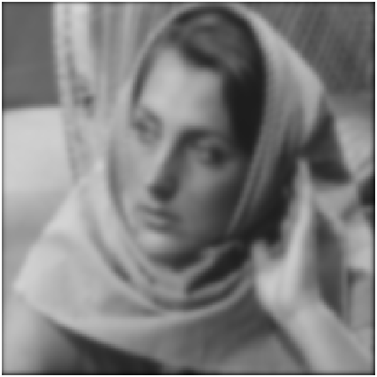



Reverse Heat Equation ~ Barbara ~ 𝝈 = 2,3 Gaussian Blur
Technique
Coarse grid search on parameters followed
by manual parameter fine tuning
Observations
For high standard deviation gaussian blur,
we are not able to achieve visually good deblur
Parameters - 𝜎 = 2
c = 0.71, 𝜷 = 0.09, dt = 1, n_iter = 10, 𝜽 = 0.1
Convergence at 4th iteration
Parameters - 𝜎 = 3
c = 0.8, 𝜷 = 0.07, dt = 1, n_iter = 10, 𝜽 = 0.05
Convergence at 4th iteration
Original Barbara
𝝈 = 2: PSNR = 22.48dB
𝝈 = 2: PSNR = 24.04dB
𝝈 = 3: PSNR = 21.48dB
𝝈 = 3: PSNR = 22.56dB

Slide 8
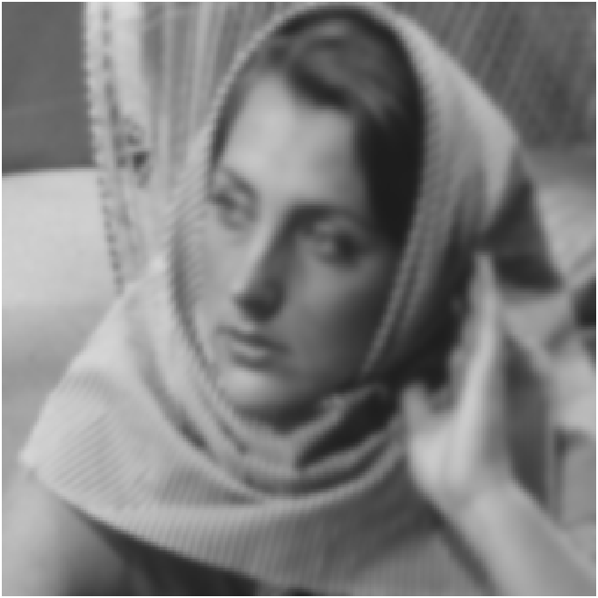



Reverse Heat Eqn ~ Barbara ~ Gaussian Space Varying Blur
Significant improvement in PSNR using Reverse Heat Equation for deblurring
Technique
Started off with parameters of 𝜎 = 2, followed
by manual parameter fine tuning
Observations
We do observe deblurring but space-varying problem is not tackled at a satisfactory level
Parameters - 𝜎 = 1-2
c = 1.00, 𝜷 = 0.01, dt = 0.1, n_iter = 10, 𝜽 = 1
Parameters - 𝜎 = 3
c = 1.2, 𝜷 = 0.06, dt = 0.1, n_iter = 10, 𝜽 = 1
Original Barbara
𝝈=1-2: PSNR = 24.19dB
𝝈=1-2: PSNR = 26.68dB
𝝈=1-3: PSNR = 23.47dB
𝝈=1-3: PSNR = 24.39dB

Slide 9
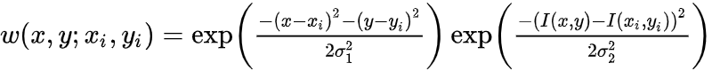
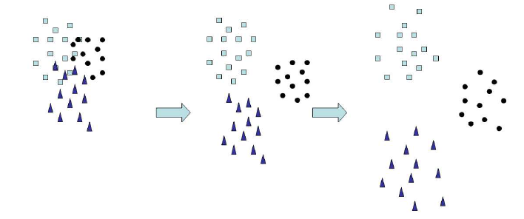
Reverse Mean Shift (Deblurring)
w = weights
I = pixel intensity
𝛔₁ = spacial kernel std
𝛔₂ = intensity kernel std
s₂ = update step size
Modifications & Implementation Details
Single update per pixel per time step :
For each pixel, at each time step, the intensity value is
updated based on the mean shift vector calculated using
the pixel’s neighbours in the feature space
Stopping criterion for iterations
The reverse mean shift iterations are continued until
PSNR of the updated image decreases as compared to
the current image

Slide 10
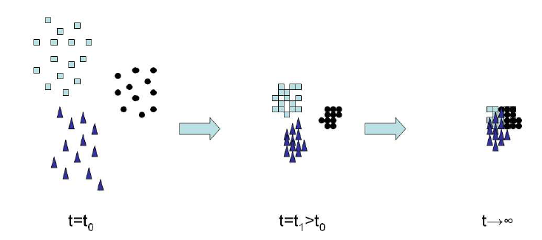
Forward Mean Shift (Denoising)
w = weights
I = pixel intensity
𝛔₃ = spacial kernel std
𝛔₄ = intensity kernel std
s₁ = update step size
Modifications & Implementation Details
Single update per pixel per time step:
For each pixel, at each time step, the intensity value is
updated based on the mean shift vector calculated using
the pixel’s neighbours in the feature space
Stopping criterion for iterations:
The forward mean shift iterations are continued until
PSNR of the updated image decreases as compared to
the current image

Slide 11
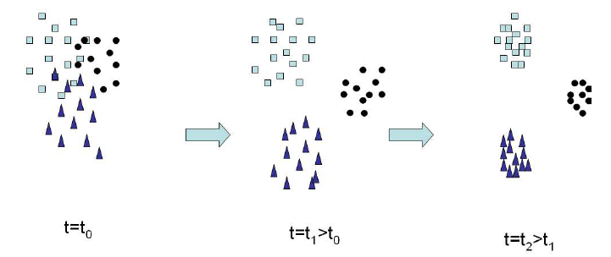
Deblurring and Denoising Together
Implementation Details
Double update per pixel per time step:
For each pixel, at each time step, the intensity value
is updated based on the reverse mean shift vector and
reverse step-size first, followed by the forward mean
shift vector and forward step size
Stopping criterion for iterations:
The combined mean shift iterations are continued
until the PSNR of the updated image decreases as
compared to the current image
Stability through forward and reverse step sizes:
The forward and reverse step sizes control the relative
amount of clustering and declustering. Fine-tuning
these parameters induces a stability effect, which gives
better results as compared to performing only forward
or only reverse mean shift.

Slide 12



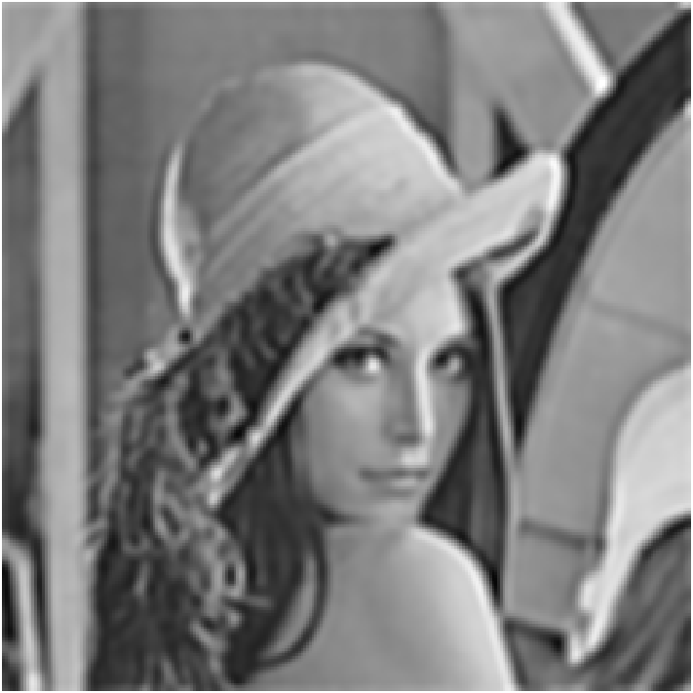
Reverse Mean Shift ~ Lena ~ 𝝈 = 2 Gaussian Blur
Technique
Coarse grid search on parameters followed
by manual parameter fine tuning
Observations
Better PSNR with both forward and reverse iterations with step smaller in forward
Higher standard deviation of space and intensity kernels in reverse mean shift as compared to forward ensures we get more number of clusters in forward iteration
Parameters - 𝜎 = 2
𝝈₁ = 20, 𝝈₂ = 100, 𝝈₃ = 2, 𝝈₄ = 10, s₁ = 0.03, s₂ = 0.1
Convergence at 17th iteration
Original Lena
𝝈 = 2: PSNR = 24.21dB
iter = 5: PSNR = 25.46dB
iter = 10: PSNR = 26.78dB
iter = 17: PSNR = 27.88dB

Slide 13




Forward Mean Shift ~ Lena ~ 𝝈 = 10 Gaussian Noise
Technique
Coarse grid search on parameters followed
by manual parameter fine tuning
Observations
Forward mean shift with only pixel intensity updates is equivalent to denoising the image
Low space and intensity standard deviations ensure that there is no segmentation
Significant improvement in PSNR is observed
Parameters - 𝜎 = 10
𝝈₁ = 20, 𝝈₂ = 100, 𝝈₃ = 2, 𝝈₄ = 10, s₁ = 0.1, s₂ = 0
Convergence at 21st iteration
Original Lena
PSNR = 28.01dB
iter = 7: PSNR = 29.63dB
iter = 15: PSNR = 31.02dB
iter = 21: PSNR = 31.31dB

Slide 14
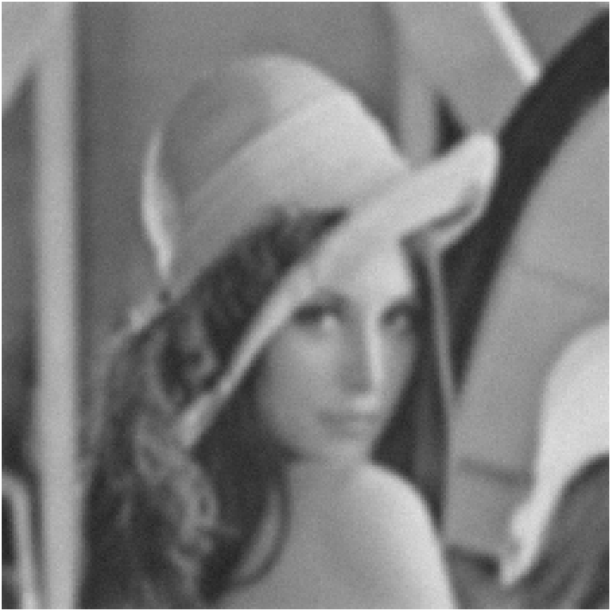


Mean Shift ~ Lena ~ 𝝈 = 2 Blur + 𝝈 = 3 Noise
Technique
Coarse grid search on parameters followed
by manual parameter fine tuning
Observations
We had to keep the step fractions similar for both reverse and forward mean shifts since we want to do both deblurring (reverse mean shift) and denoising (forward mean shift) at par
We do see both deblurring and denoising effects happening
Parameters - 𝜎ₙ = 3, 𝜎ₕ = 2
𝝈₁ = 20, 𝝈₂ = 100, 𝝈₃ = 2, 𝝈₄ = 5, s₁ = 0.08, s₂ = 0.1
Convergence at 11th iteration
Original Lena
PSNR = 24.15dB
iter = 3: PSNR = 24.71dB
iter = 6: PSNR = 25.26dB
iter = 11: PSNR = 25.75dB

Slide 15




Mean Shift ~ Lena ~ Space-Varying Gaussian Blur
Technique
Coarse grid search on parameters followed
by manual parameter fine tuning
Observations
Testing deblurring for space-varying Gaussian blur using reverse mean shift algorithm was just an experiment
We observe that the deblurring is observed but it is not consistent and up to our expectations, as were set by the reverse heat equation
Parameters - 𝜎 = 1-3
𝝈₁ = 20, 𝝈₂ = 100, 𝝈₃ = 2, 𝝈₄ = 10, s₁ = 0.01, s₂ = 0.1
Convergence at 15th iteration
Original Lena
PSNR = 23.81dB
iter = 5: PSNR = 24.78dB
iter = 10: PSNR = 26.17dB
iter = 15: PSNR = 26.96dB

Slide 16
Summary
Reverse Heat Equation for Deblurring
Experimented with different values of all parameters (diffusion coefficient, stability term coefficient, update decision variable, update time resolution)
Achieved significant deblurring in terms of deblurring in Lena, Kodak and Barbara images, with both non space-varying and space-varying gaussian blurs
Forward and Reverse Mean Shift for Denoising and Deblurring
Experimented with different values of all parameters (spatial and intensity standard deviations and update sizes for both forward and reverse mean shift)
Forward mean shift gives significant denoising
Reverse mean shift, along with slightly suppressed forward mean shift gives significant deblurring on gaussian non space-varying blur
This is not optimal for deblurring images which have space-varying blurs

Slide 17
Thank you!
Ashutosh Sharma: ashutosh.sharma@iitb.ac.in
Kritti Sharma: kritti.sharma@iitb.ac.in
Shreyas Chandgothia: shreyaschandgothia@gmail.com

